Slide 1

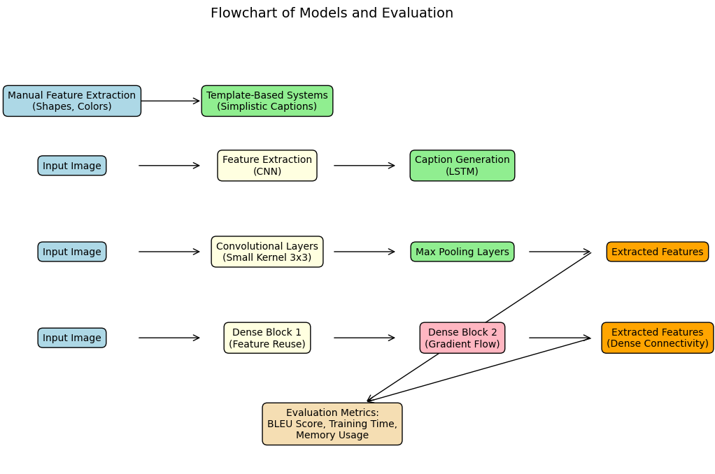
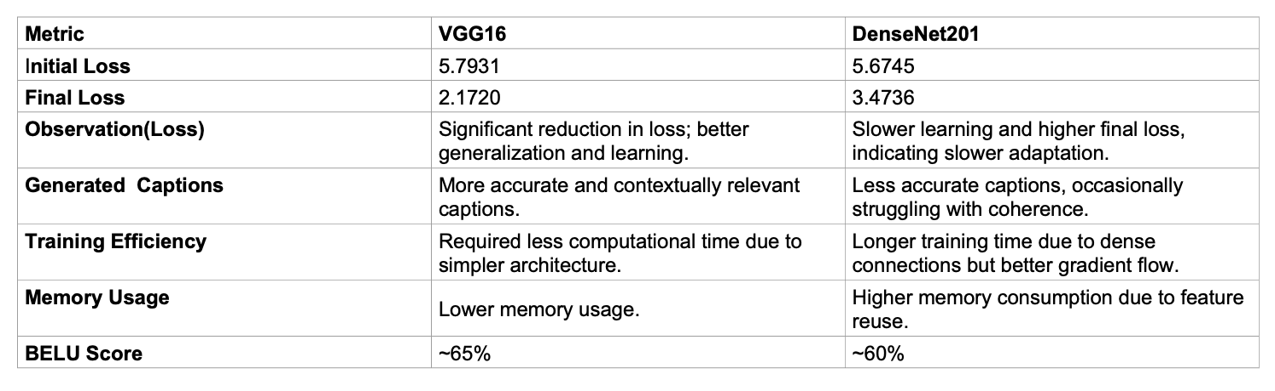
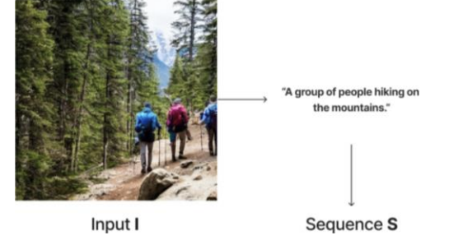
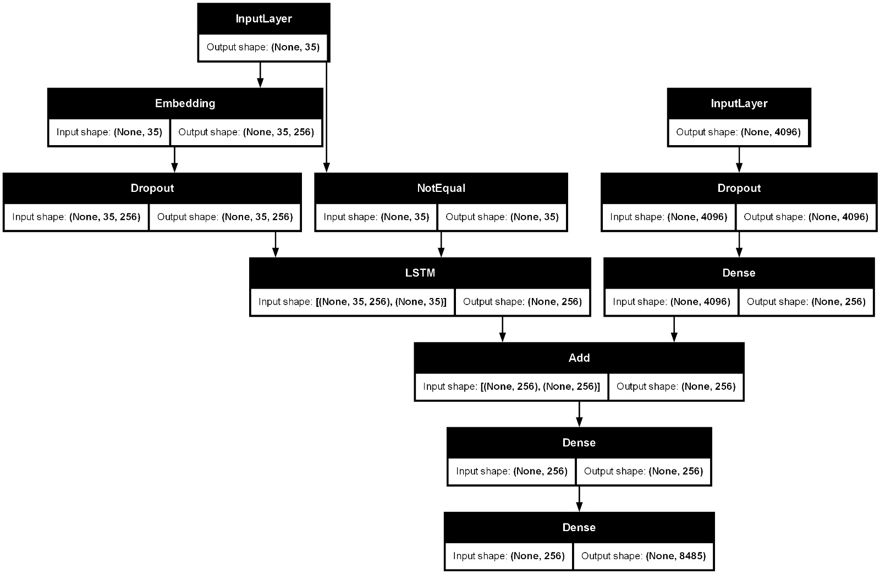
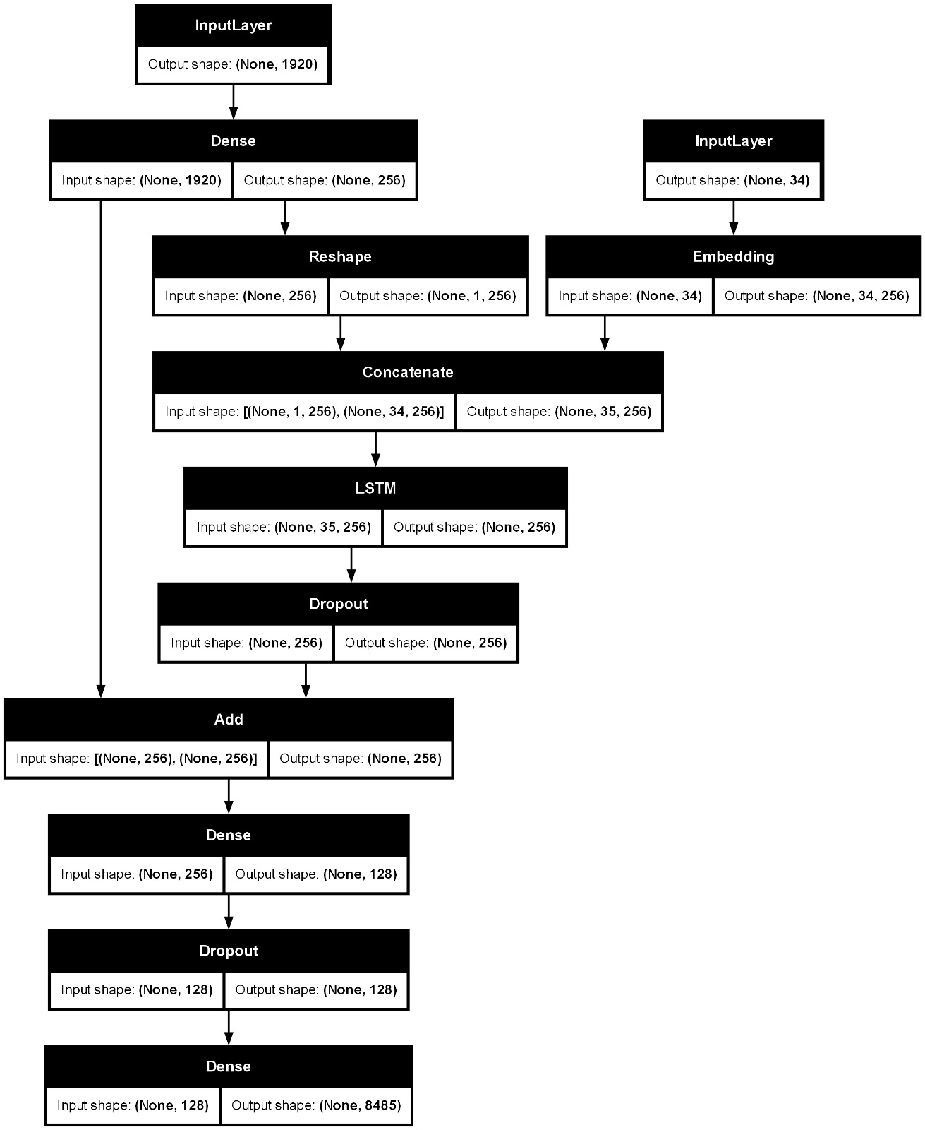
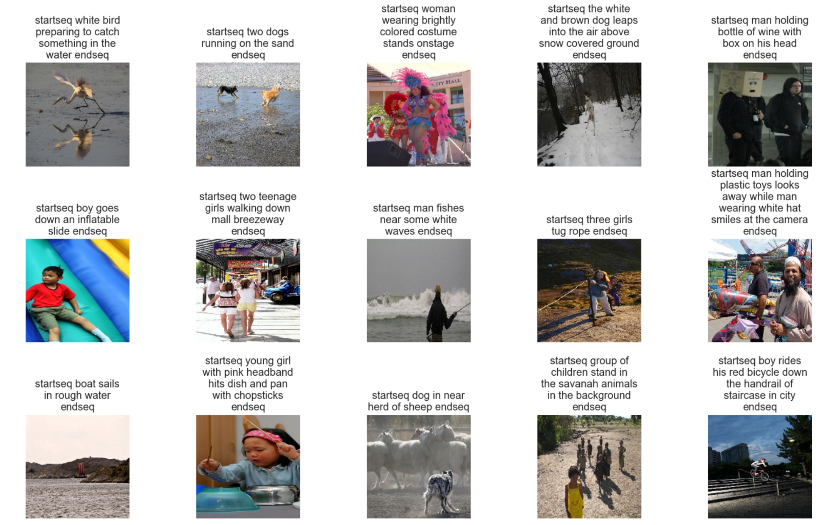
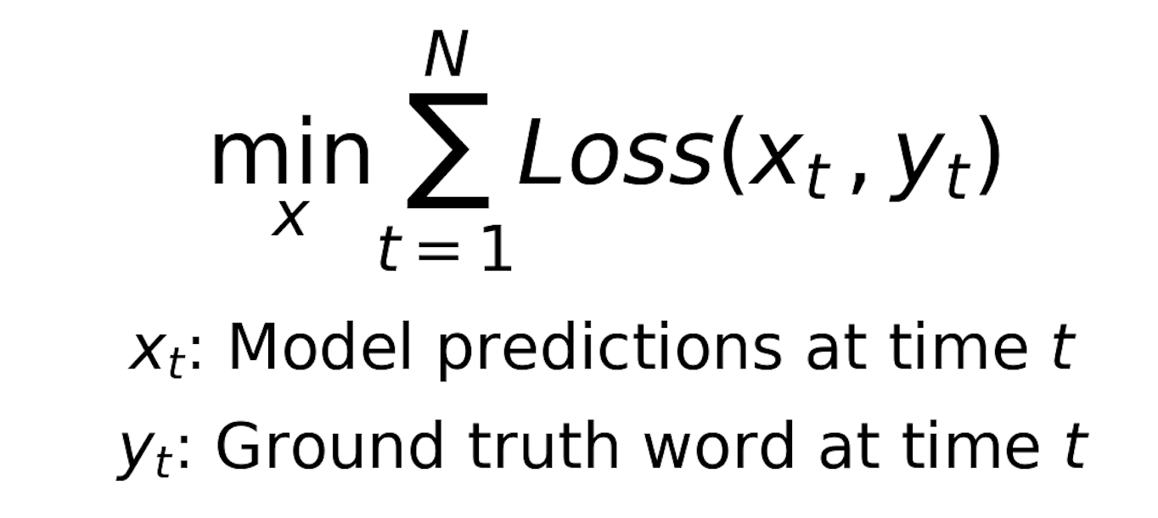
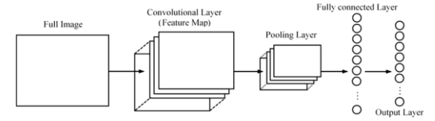
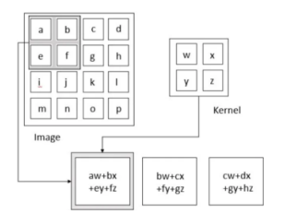
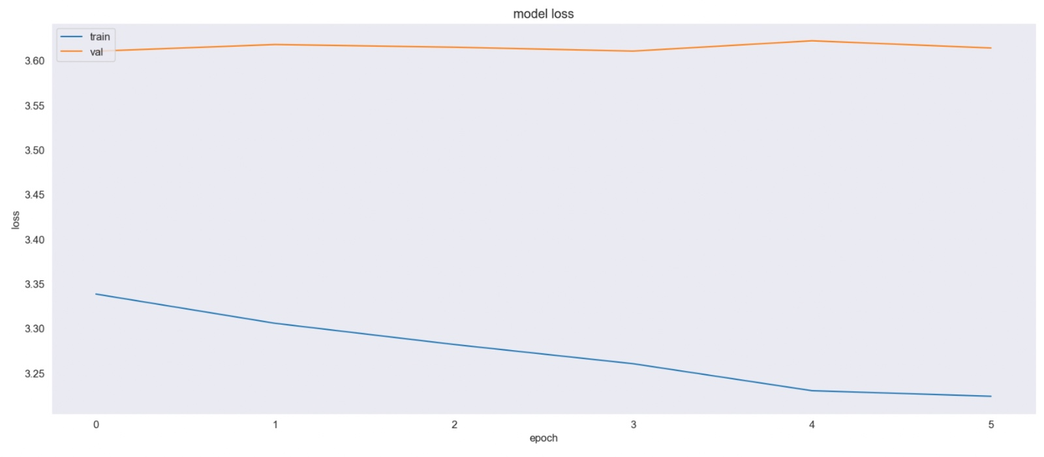
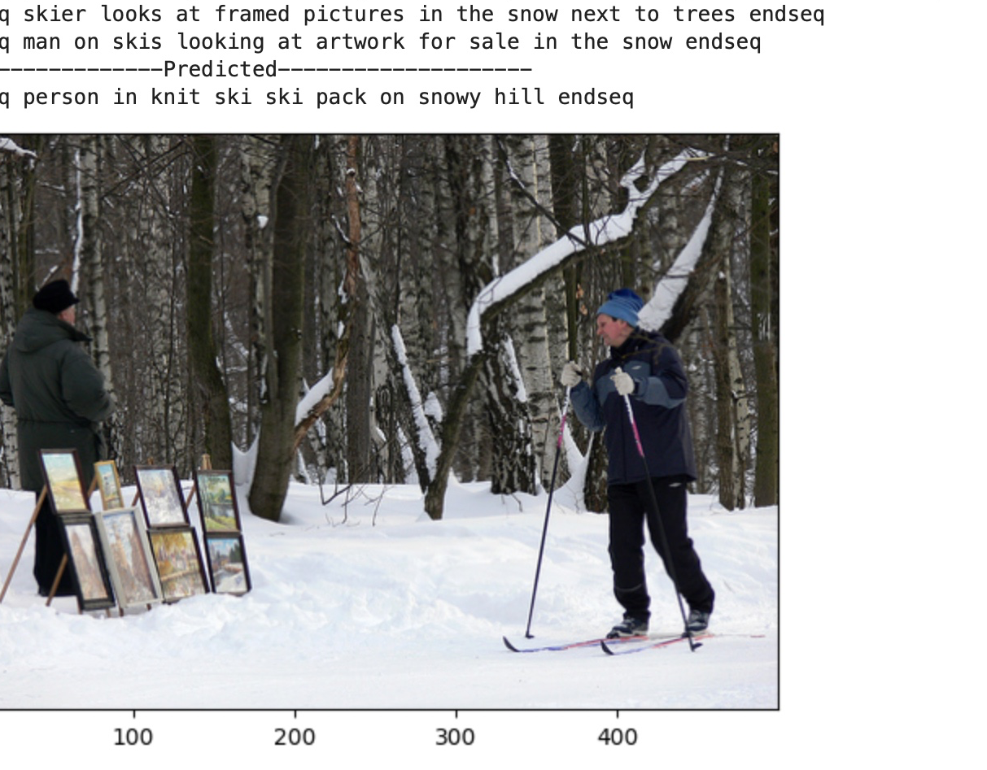

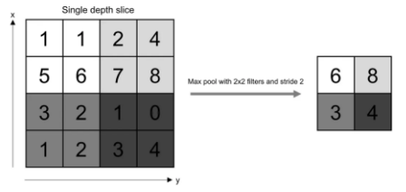
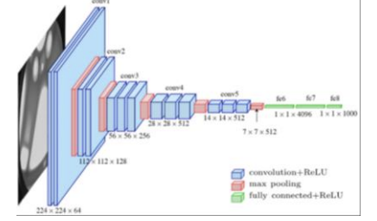
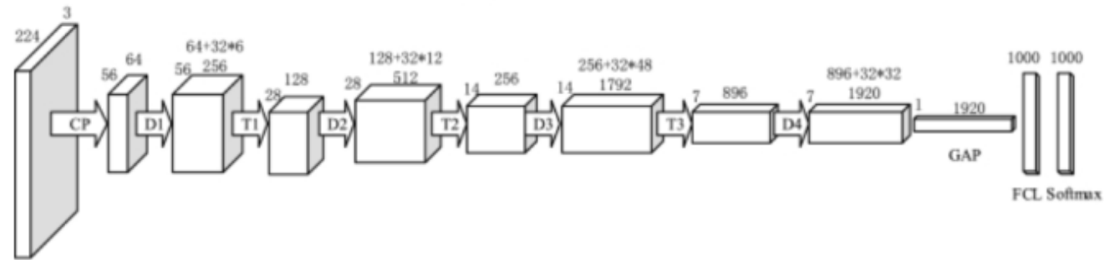
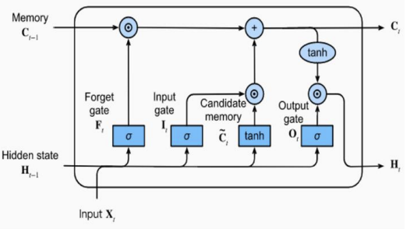
Comparing Image Captioning Models: VGG16 and DenseNet 201
Srilekha Rayedi and Harshith Makkapati, University of Houston
Motivation Applications
Existing Methods
Performance Analysis
Creating captions for images involves computer vision and natural language processing to form textual interpretations of visual content. In this project we are evaluating two models(VGG16 and DenseNetx 201) for an image captioning system. It is a Combination of Convolutional Neural Networks (CNNs) and Long Short-Term Memory networks (LSTMs) to process and narrate visual data. We aim to distinguish how different image captioning is by comparing it with two models and utilizing the Flickr 8k dataset for validation. Our approach involves using a pretrained CNN to identify crucial features in images and integrating these features into the LSTM part of our model, which is responsible for generating consistent and context-aware captions.
Early Image Annotation Techniques [Before 2010]
Manual extraction of visual elements (shapes, colors) combined with template-based systems.
Challenges: Limited contextual understanding and generalization, leading to simplistic captions.
Neural Image Captioning (NIC) [Vinyals et al., 2015]
End-to-end trainable model using:
CNNs for feature extraction.
LSTMs for generating descriptive captions.
Advantages: Human-like captions with improved accuracy using large datasets like MS-COCO.
VGG16 [Simonyan and Zisserman, 2014]
Deep CNN with sequential layers, small kernel sizes (3x3), and max pooling.
Strength: Effective feature extraction for complex image tasks.
Limitations: Higher computational cost compared to simpler models.
DenseNet201 [Huang et al., 2017]
Introduces dense connections between layers for:
Better gradient flow.
Enhanced feature reuse.
Strength: Improved performance for complex image features.
Limitations: Increased training time due to dense connectivity.
Loss Score of VGG16 and DenseNet 201
Figure 1: Model generating the caption for the image.
Methods | Strengths | Weaknesses
Early Methods | Simplicity | Lacked context and generalization
NIC | Human-like captions, end-to-end design | Requires large datasets
VGG16 | Efficient feature extraction | High computational cost
DenseNet201 | Feature reuse, gradient optimization | Slower training times.
Figure 8: The implementation of VGG16 model
Formulation
Figure 9: The implementation of DenseNet201 model
Image Captioning with Deep Learning Architectures
Experiments
Objective
Develop an image captioning system using CNNs (e.g., VGG16 and DenseNet201) for feature extraction and LSTM networks for sequence generation.
Minimize the overall loss while ensuring accurate caption generation and maintaining computational efficiency.
Dataset
Flickr8k: 8,000 images with human-generated captions.
Split: 6,000 (training), 1,000 (validation), 1,000 (testing).
Preprocessing: Resize to 224x224, clean captions, and add <start>/<end> tokens.
Model Training Feature Extraction:
Models: VGG16 and DenseNet201 (pre-trained on ImageNet).
Extract features from the last convolutional layer.
Caption Generation:
LSTM decodes features to generate captions.
Training Details:
Batch Size: VGG16 (32), DenseNet201 (64).
Optimizer: Adam with learning rate decay.
Loss Function:
Environment: Jupyter Notebook.
Resources: CPU and GPU for training.
Algorithm Design
Framework and Architecture for CNN-LSTM Image Captioning
Evaluation
Metrics:
BLEU Scores: Assess caption quality.
Training Time & Memory Usage: Measure computational efficiency.
Goal: Minimize the loss over N time steps, where:
The loss function is typically cross-entropy loss, which measures the difference between the predicted word probabilities and the actual word.
Figure 2: Basic structure of Convolutional Neural Network(CNN)
Figure 3: Convolution Layer Operation
This study systematically evaluated the capabilities of sophisticated deep learning architectures, notably VGG16 and DenseNet201, in the field of picture captioning. We proved, using the Flickr8k dataset, which combining Convolutional Neural Networks (CNNs) with Long Short-Term Memory (LSTM) networks to compare the relevancy of generated picture captions. The VGG16 model, with its deep yet simple architecture, has demonstrated impressive ability to extract precise visual features, whereas DenseNet201's complicated connection pattern has proven critical in guaranteeing robust feature propagation and successful learning. Our findings confirm that the strategic combination of these models enables a more sophisticated comprehension and development of natural language descriptions of pictures, therefore bridging a significant gap between visual data perception and language representation. This innovation not only advances academic research in picture captioning, but it also prepares the way for practical applications in a variety of disciplines, including automated surveillance, assistive devices for the visually impaired, and improved engagement with digital media.
Feature Fusion:
Visual Features: CNN(Image): Extracted from the image using a CNN model like VGG16 or DenseNet201. Textual Context: LSTM(Text Embedding)): Generated by embedding words and passing them through an LSTM to capture sequential dependencies.
The fusion ensures that both image content and textual context contribute to generating the next word in the caption.
Figure 6: DenseNet201 architecture
Figure 4: Max Pooling Operation
Figure 5: VGG16 architecture
Figure 7: Architecture of LSTM Unit
References
Input Processing:. Resize input images to 224 × 224 224×224.
Tokenize and pad captions to a fixed length.
Benefits:
[1] Vinyals, O., Toshev, A., Bengio, S., & Erhan, D. (2015). Show and tell: A neural image caption generator. In Proceedings of the IEEE conference on computer vision and pattern recognition (pp. 3156-3164).
[2] Karpathy, A., & Fei-Fei, L. (2015). Deep visual-semantic alignments for generating image descriptions. In Proceedings of the IEEE conference on computer vision and pattern recognition (pp. 3128-3137).
[3] Md. Zakir Hossain, Ferdous Sohel, Mohd Fairuz Shiratuddin, and Hamid Laga. (2018). A Comprehensive Survey of Deep Learning for Image Captioning. ACM Comput. Surv. 51, 6, Article 118 (February 2019), 36 pages. https://doi.org/10.1145/3295748
[4] Md. S. Takkar, A. Jain and P. Adlakha, "Comparative Study of Different Image Captioning Models," 2021 5th International Conference on Computing Methodologies and Communication (ICCMC), Erode, India, 2021, pp. 1366- 1371, doi: 10.1109/ICCMC51019.2021.9418451.
[5] Zhiyong Cui, Ruimin Ke, Ziyuan Pu, Yinhai Wang,Stacked bidirectional and unidirectional LSTM recurrent neural network for forecasting network-wide traffic state with missing values,Transportation Research Part C: Emerging Technologies,Volume 118,2020,1026
Accuracy: High BLEU score with coherent captions.
Scalability: Adaptable to different datasets.
Interpretability: Clear role of CNN for features and LSTM for sequences.
Feature Extraction: Use pre-trained CNNs (e.g., VGG16, DenseNet201) to extract visual features.
Caption Generation: An LSTM decoder generates captions sequentially by combining CNN-extracted image features with word embeddings at each step.
Challenges:
Feature Representation: Balancing compactness with detail in CNN features.
Sequence Modeling: Handling long-term dependencies in captions.
Computational Efficiency: High memory usage of DenseNet201.
Output: A complete caption generated word by word.

